Slide 1
Swine Disease Classification using Deep Learning
DATA 298B
Dr. Jerry Zeyu Gao
Team 7:
Hruthik Vinnakota
Jugal Kishore Ruvva
Rajeev Yenugula
Ramya Sudireddy

Slide 2
AGENDA
DATA PRE-PROCESSING 3
DATA PREPARATION 4
DATA ANALYTICS 5
PROPOSED MACHINE LEARNING MODELS 6
SYSTEM DESIGN 11

Slide 3



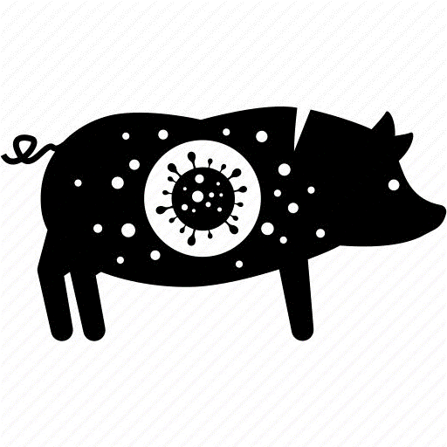
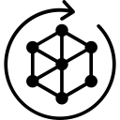
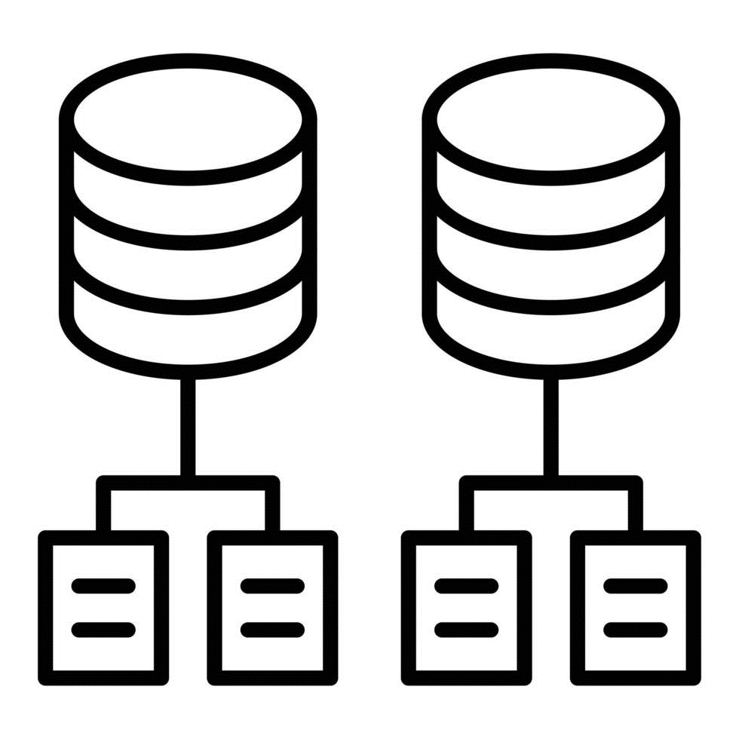


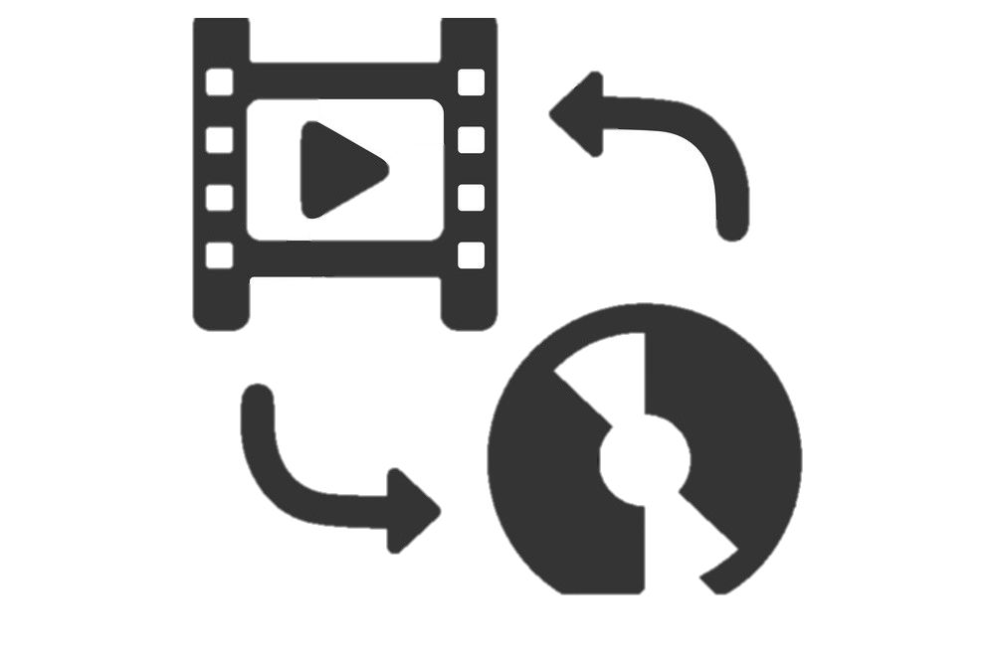

Data Flow
Data Splitting
Different data types
Data are prepared for modeling
Data Preparation
Feature Extraction
Data Preprocessing
Data
Collection

Slide 4
Data Requirements
Task | Data Characteristics
Cough sound analysis | Audio recordings of swine coughs
Detection of swine behavior anomalies | Audio recordings of swine normal behavior
Classification of swine coughs | Labeled dataset of cough audio recordings
Skin disease classification | High-resolution skin images
Identification of common symptoms through image analysis | Diverse dataset of skin lesions associated with swine diseases

Slide 5
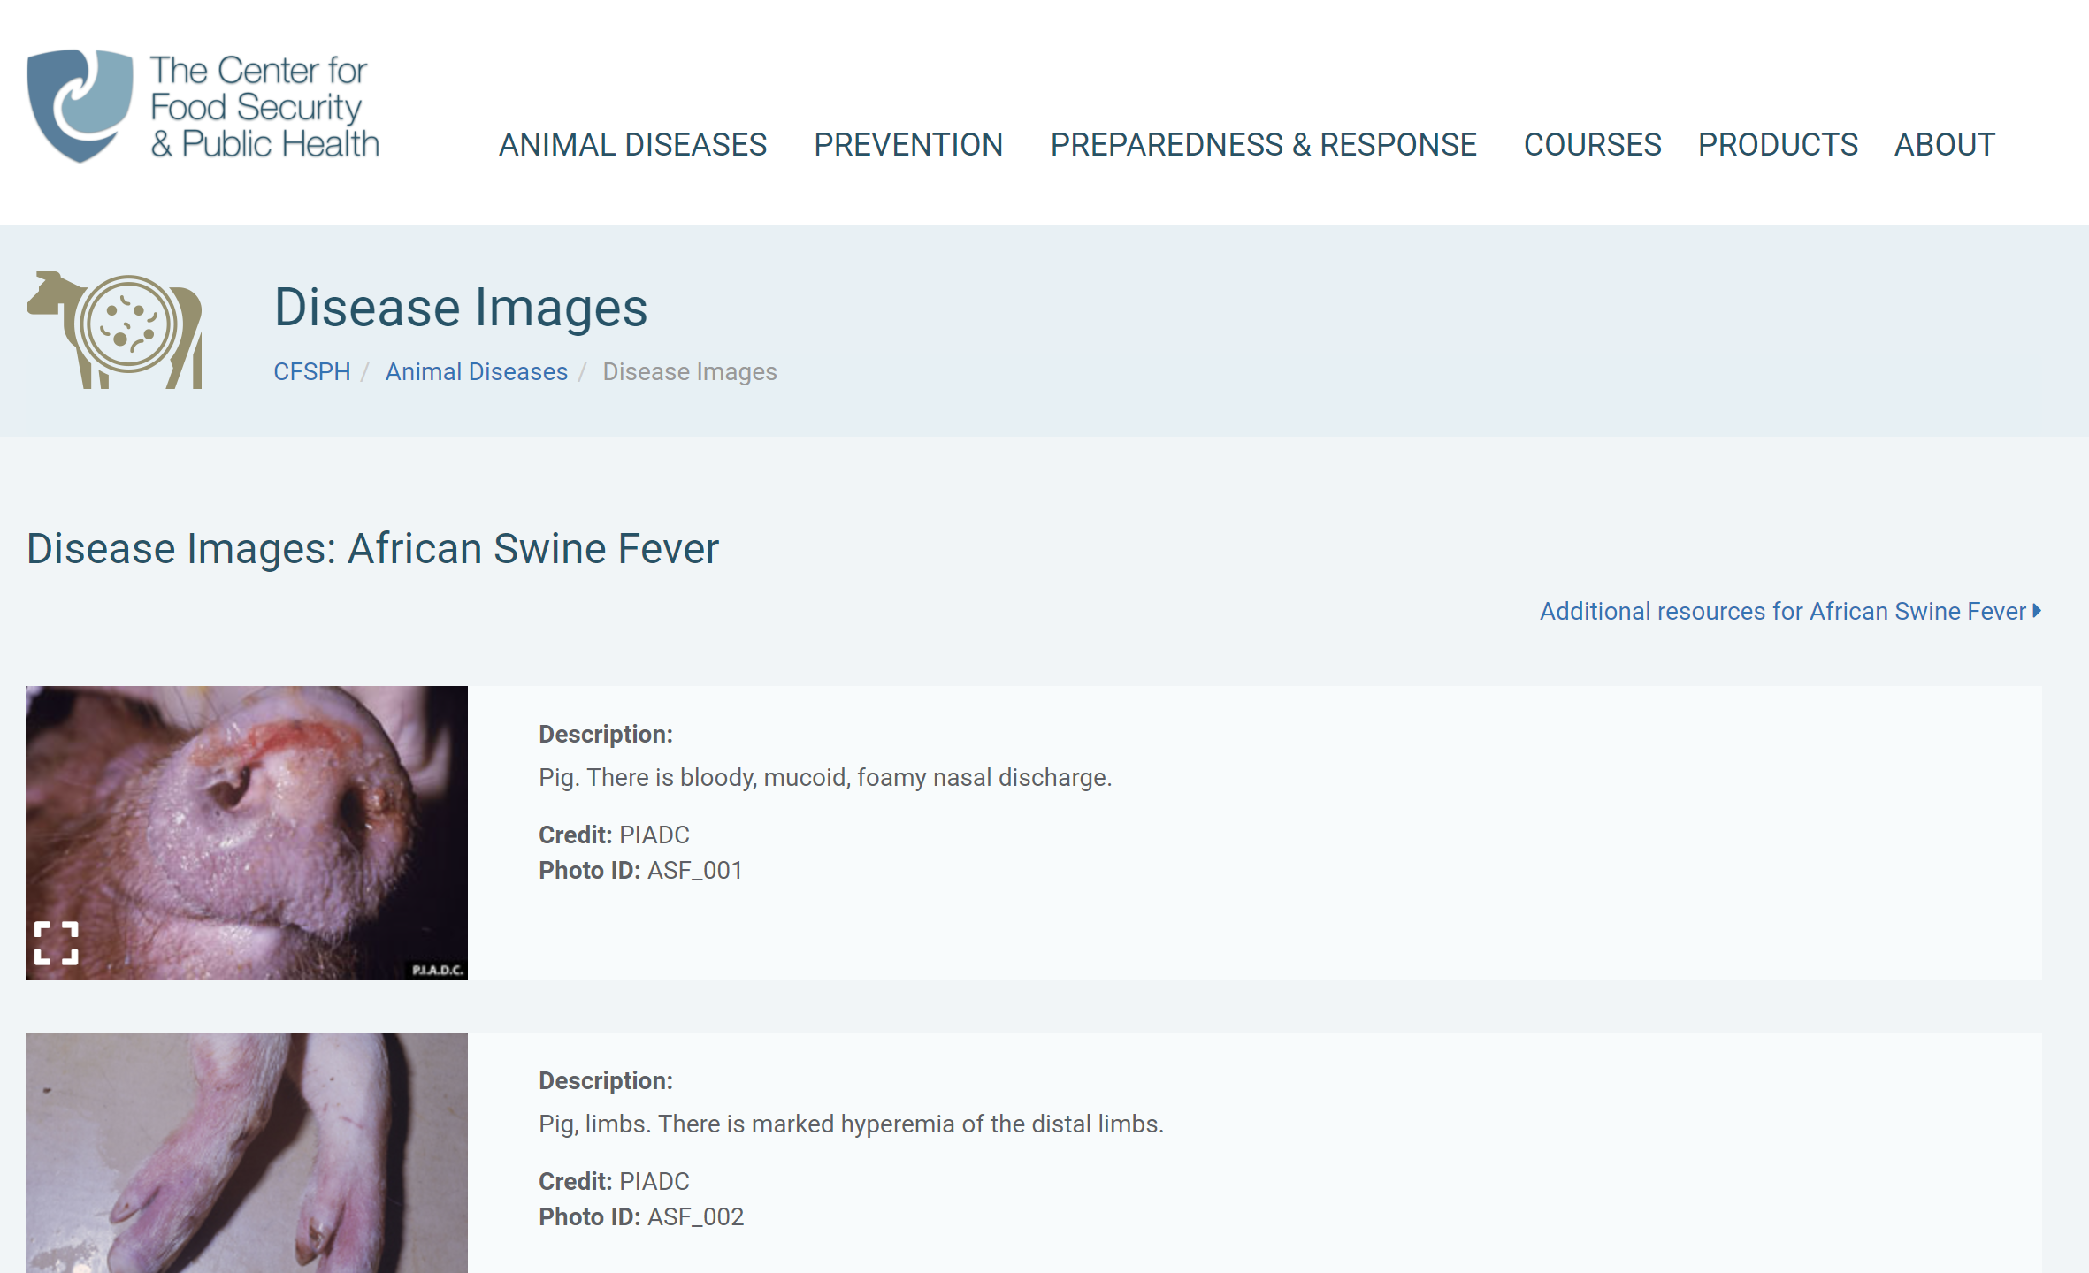
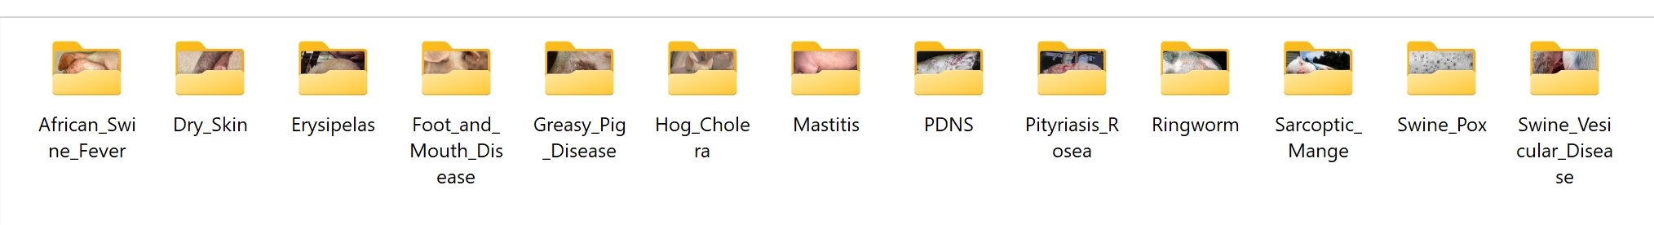
Data Collection : Image
Learn about most common skin diseases in swine.
Download swine skin images from different sources:
Iowa State University Veterinary Department
The Center for Food Security and Public Health
Cornell Veterinary Medicine
Google Search
Download .jpeg files for a total of 13 different skin diseases.

Slide 6
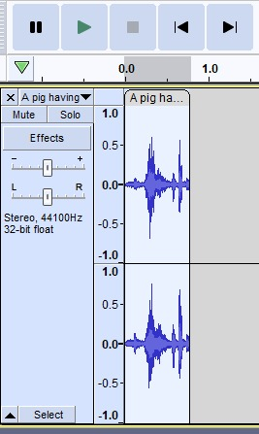
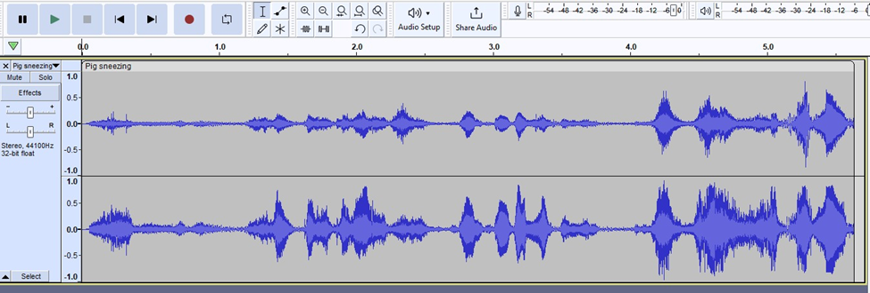
Data Collection : Audio
Selected audio and videos based on video caption and description.
Audio extracted from video using Y2mate.
Segmented cough sounds using Audacity.
Totally cough sounds extracted for 3 different disease.
Project involves amalgamation of data samples for
Pneumonia
Porcine Reproductive and Respiratory Syndrome (PRRS)
African Swine Fever in swine

Slide 7
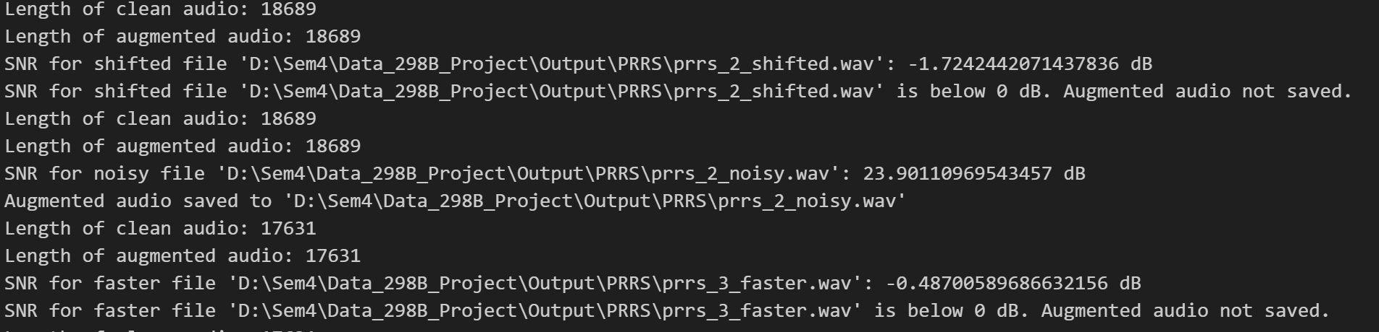
Data Pre-Processing : Audio
Applied augmentation techniques to the original dataset.
Evaluated the quality of the generated pig cough sounds
Objective evaluation involve metric Signal-to-Noise Ratio (≥10 DB)
Subjective evaluation involves listening to the sounds and assessing their similarity to real pig coughs.
Data Augmentation and Synthesis techniques includes:
Pitch Shifting
Stretching
Accelerating
Adding Noise

Slide 8
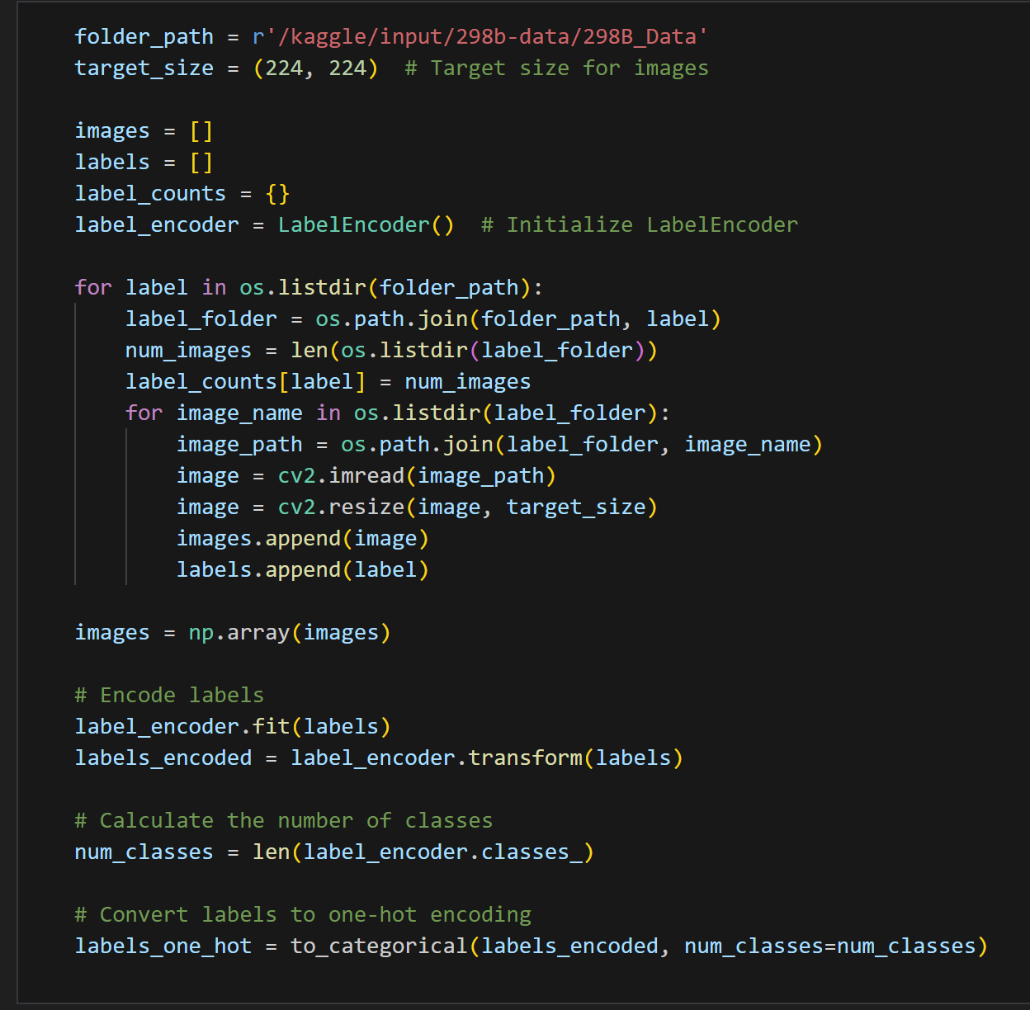
Data Pre-Processing : Image
Read the image from path and label as per the folder name.
Resize the image to (224, 224).
Decode the image from JPEG format to tensor format to obtain the pixel values, color channels.
Image augmentation – Random flip, rotation, and contrast.
Preprocess the image specific to the mode, which typically involves normalization and transformation to the format expected by the model.
Image reading and pre-processing

Slide 9





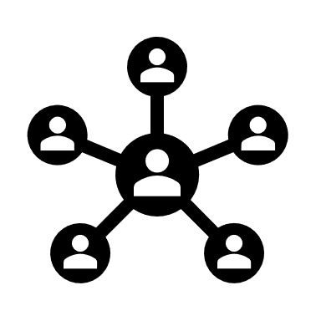





Data Preparation – Data Flow
Input Data
Data Preprocessing
Users
Audio Disease Classification
Swine disease detected
Image Disease Classification
Data Preparation

Slide 10
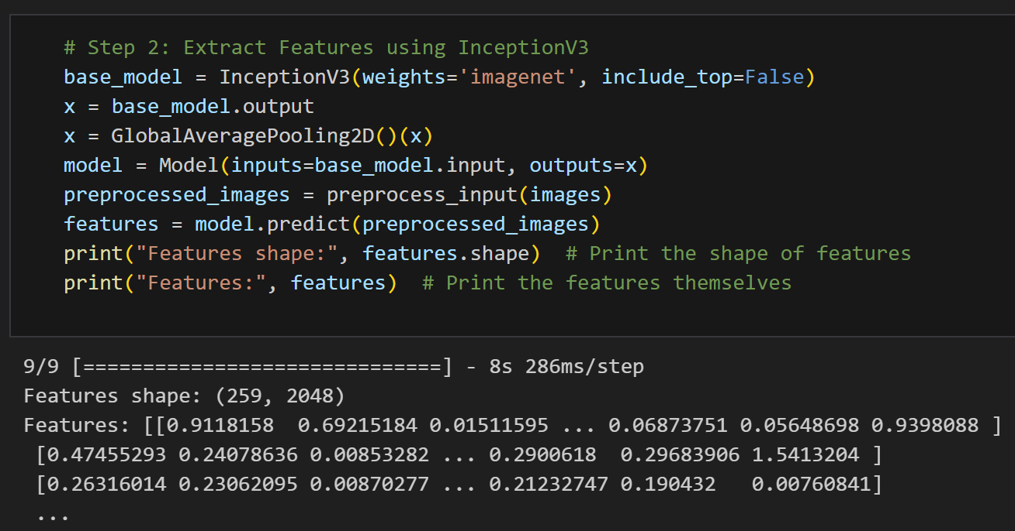
Feature Extraction
Feature extraction for Audio data using MFCC:
Extracting MFCCs involves several steps: Pre-emphasis, Frame Blocking, Fast Fourier Transform (FFT), Mel Filtering, Log Filter.
The resulting coefficients represent the compact features capturing the essential audio characteristics, which serve as valuable features.
Feature extraction for Image data:
A pre-trained CNN (Inception V3) is used to extract the features from the preprocessed images.

Slide 11
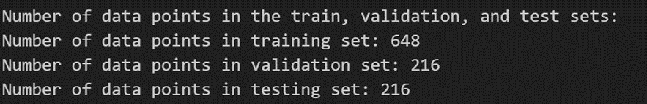
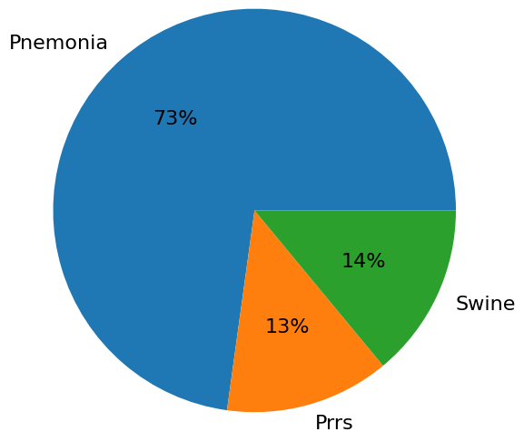
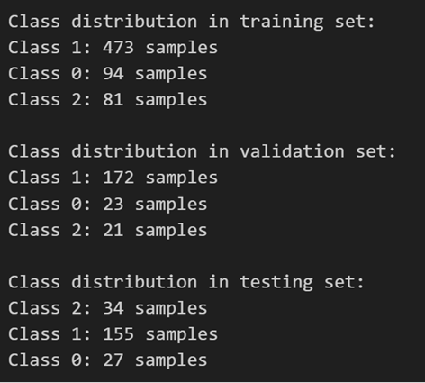
Data Preparation: Audio
The dataset is split into 60:20:20 ratio for training, validation and testing.
The number of data points in train, validation and test sets :
The class distribution after the split is as follows:

Slide 12
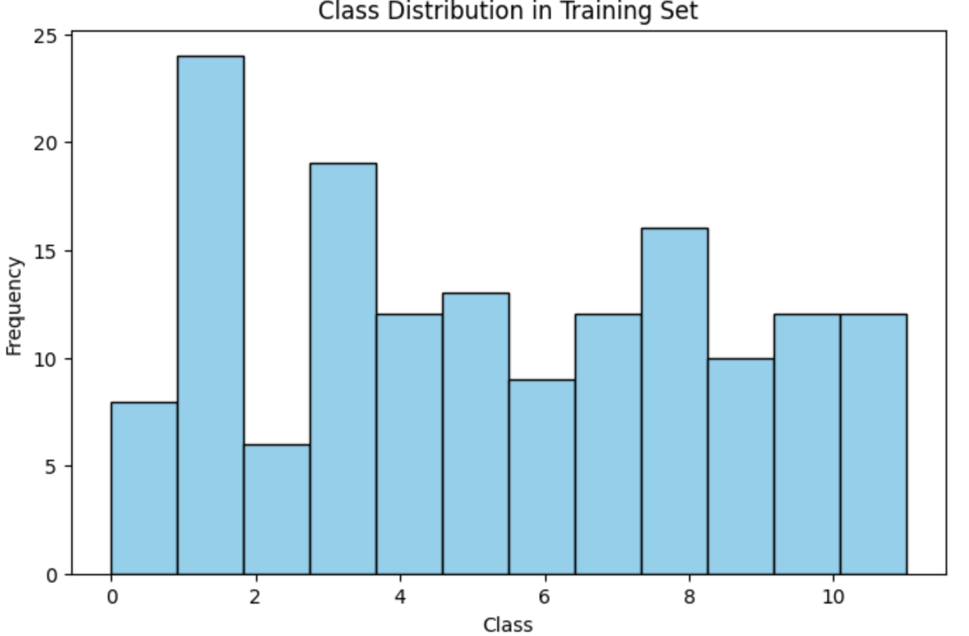
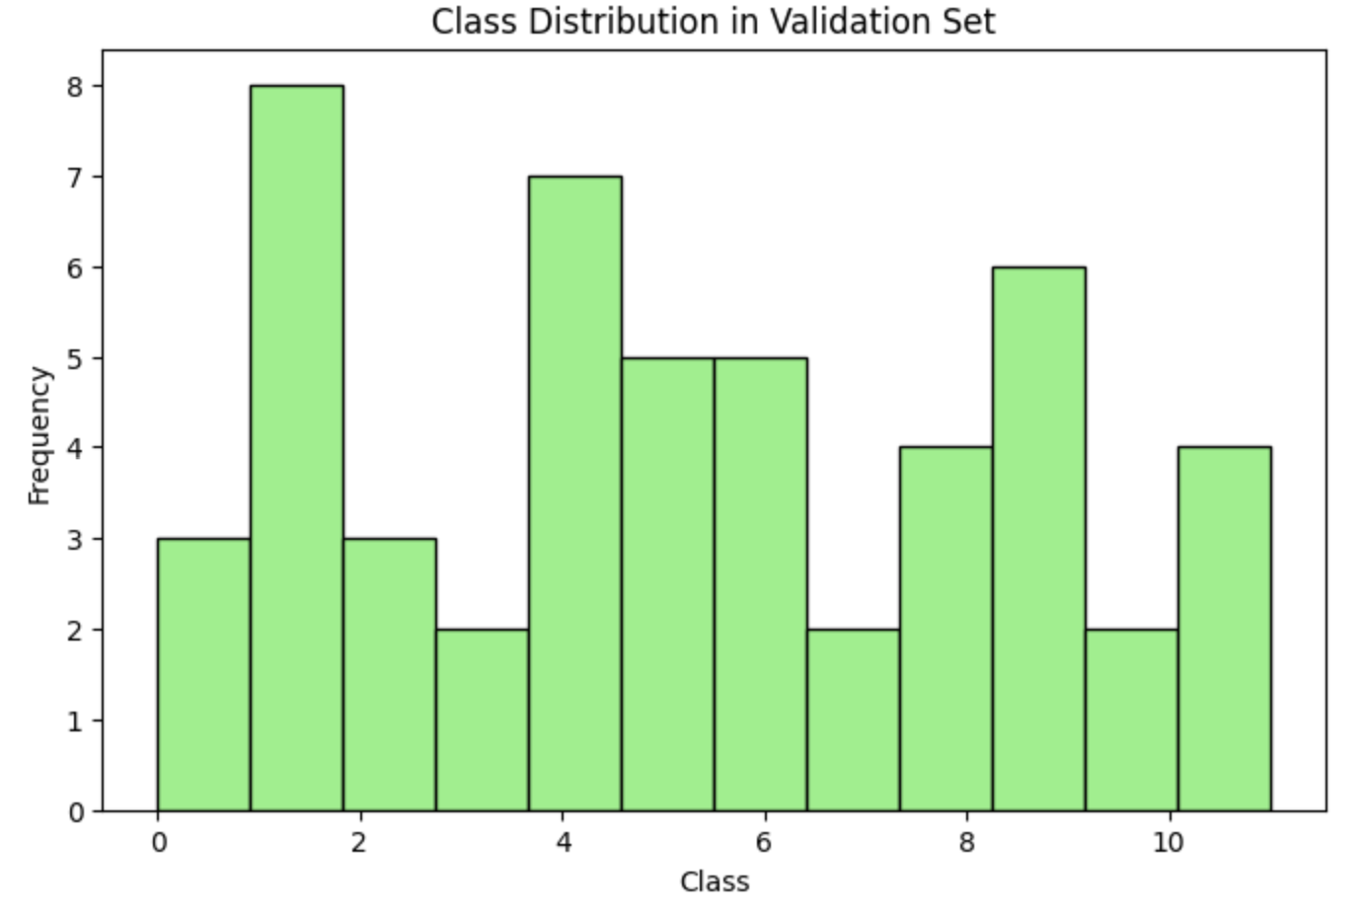
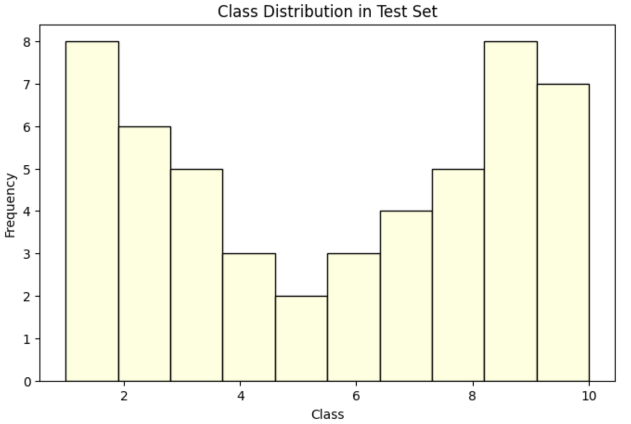
Data Preparation: Image
The dataset is split into 60:20:20 ratio for training, validation and testing.
The class distribution after the split is as follows:

Slide 13
Data Analytics Results
Big data Statistics
Stage | Dataset | Statistics
Pre-Processing | Pneumonia | 800 samples, 100 MB
 | PRRS | 136 samples, 8.21 MB
 | African Swine Fever | 144 samples, 11 MB
End of pre-processing | Processed audio dataset | 1080 samples, 119 MB
Data Transformation | Class label dataset | 976 rows x 2 columns
 | MFCC feature dataset | 1080 rows x 2 columns
 | Padded dataset | 1080 rows x 3980 columns
Data preparation | Training set | 648 rows x 3980 columns
 | Testing set | 216 rows x 3980 columns
 | Validation set | 216 rows x 3980 columns
Dataset | Statistics
Skin Disease | 259 samples, 1.5 MB
Processed image dataset | 259 samples, 1.5 MB
Feature dataset | 259 rows x 2028 columns
Training set | 155 rows x 2028 columns
Testing set | 52 rows x 2028 columns
Validation set | 52 rows x 2028 columns

Slide 14
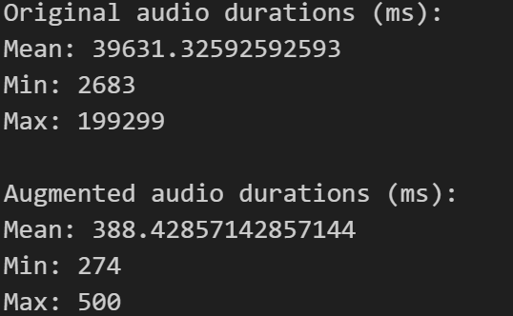
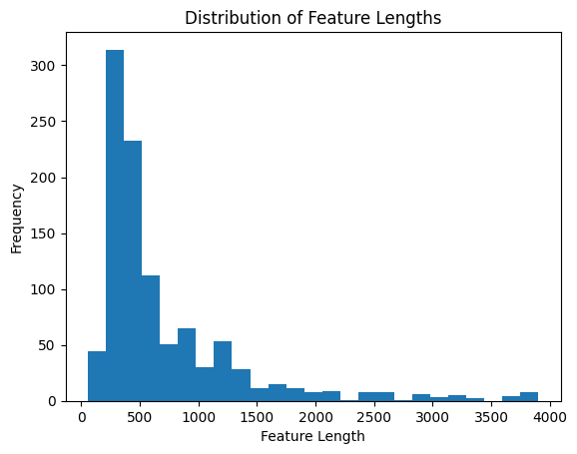
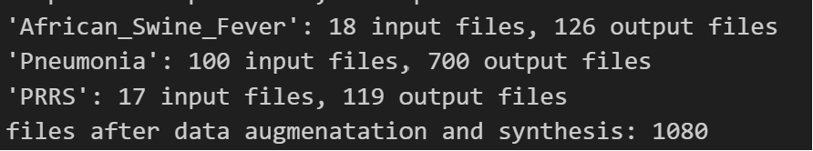
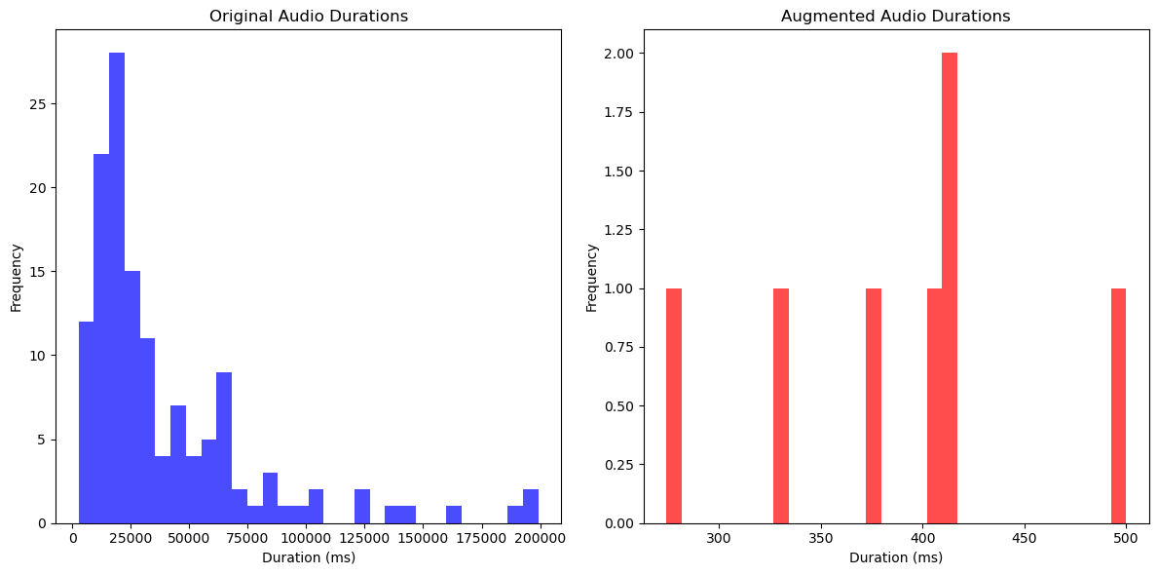
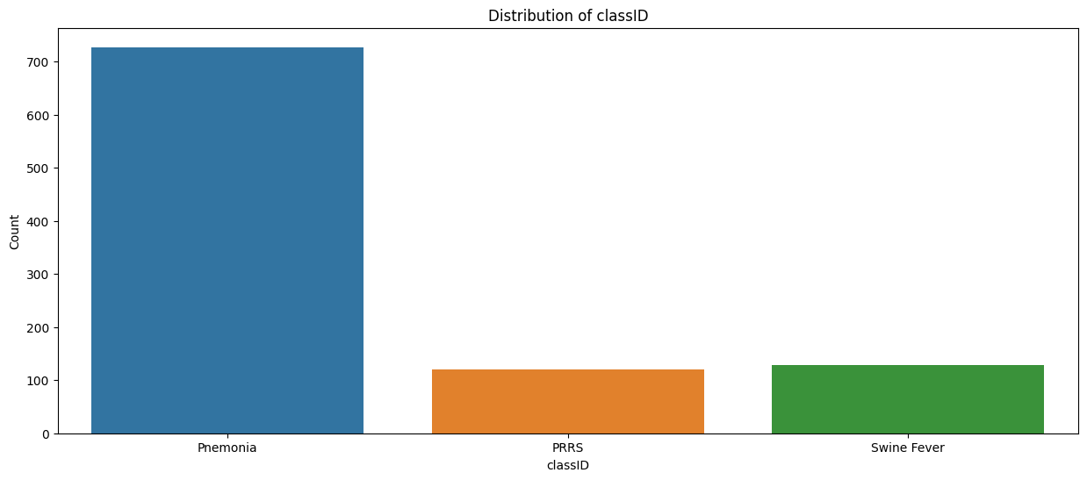
Data Analytics Results: Audio

Slide 15
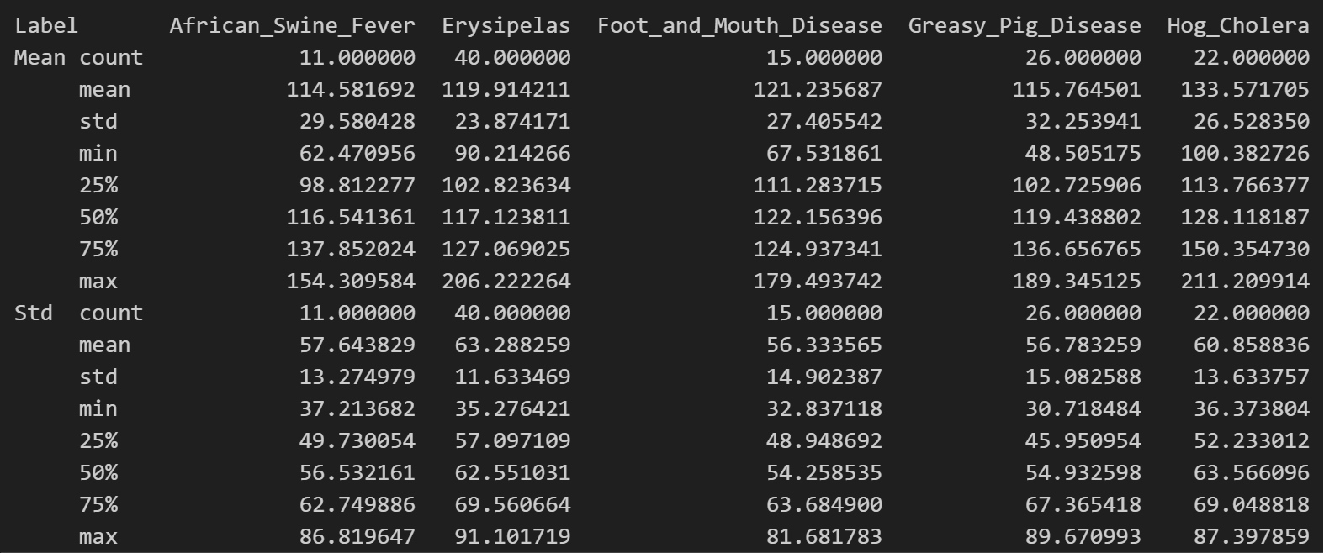
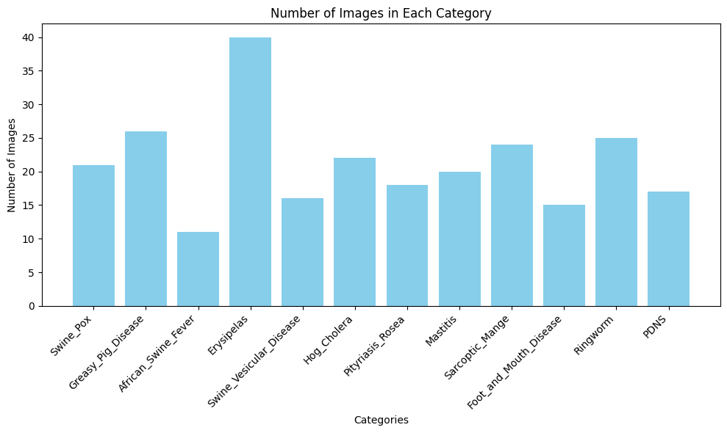
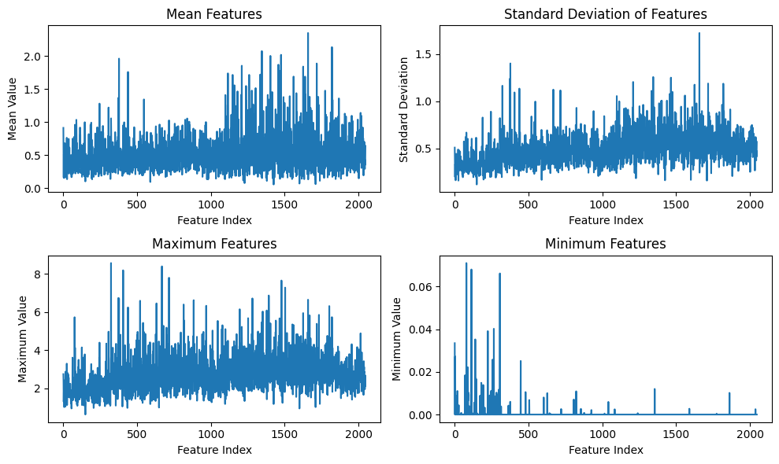
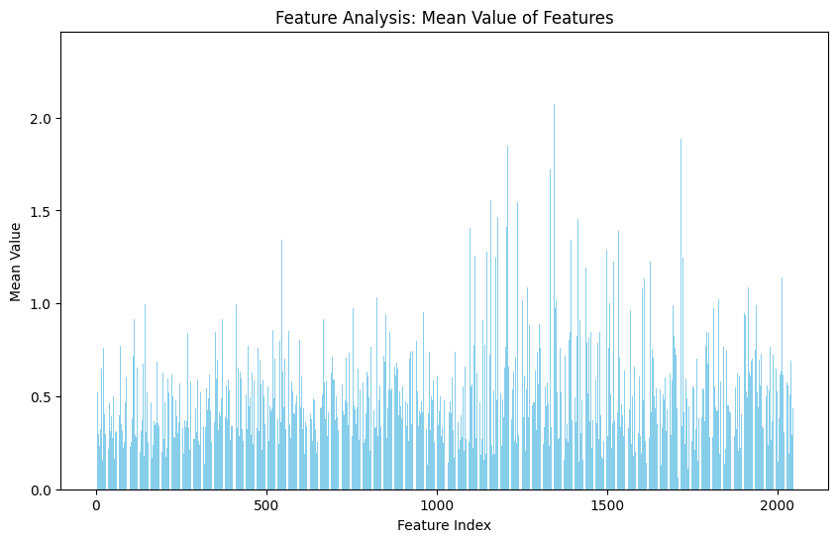
Data Analytics Results: Image

Slide 16
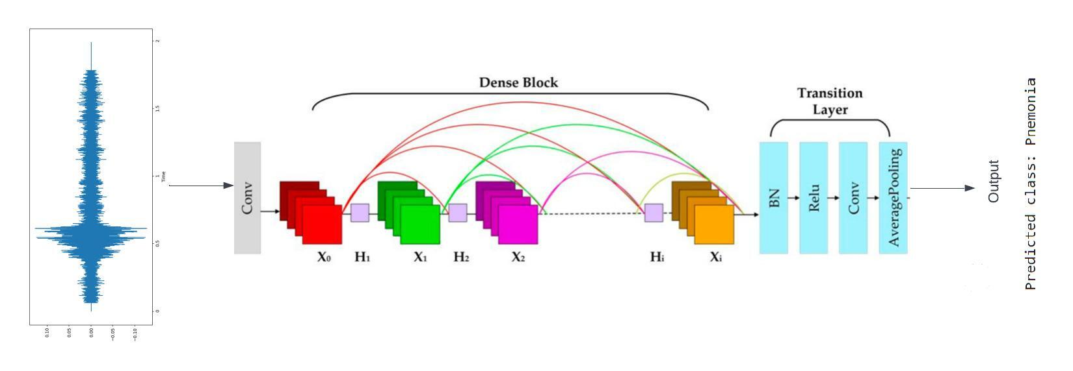
Proposed Models
DenseNet
Dense Convolutional Network (DenseNet):
A densely connected CNN architecture where each layer is connected to every other layer in a feed-forward fashion.
This connectivity pattern enhances feature propagation resulting in solid feature learning.
Notes:
Coming to the proposed models
Initially, we experimented with machine learning models such as SVC and random forest. Following the guidance of our professor, we transitioned to more advanced models, including DenseNet, ResNet, RNN, LSTM, and MobileNet, considered to be among the best in the field.
A DenseNet is a type of convolutional neural network that utilises dense connections between layers, through Dense Blocks, where we connect all layers (with matching feature-map sizes) directly with each other.

Slide 17
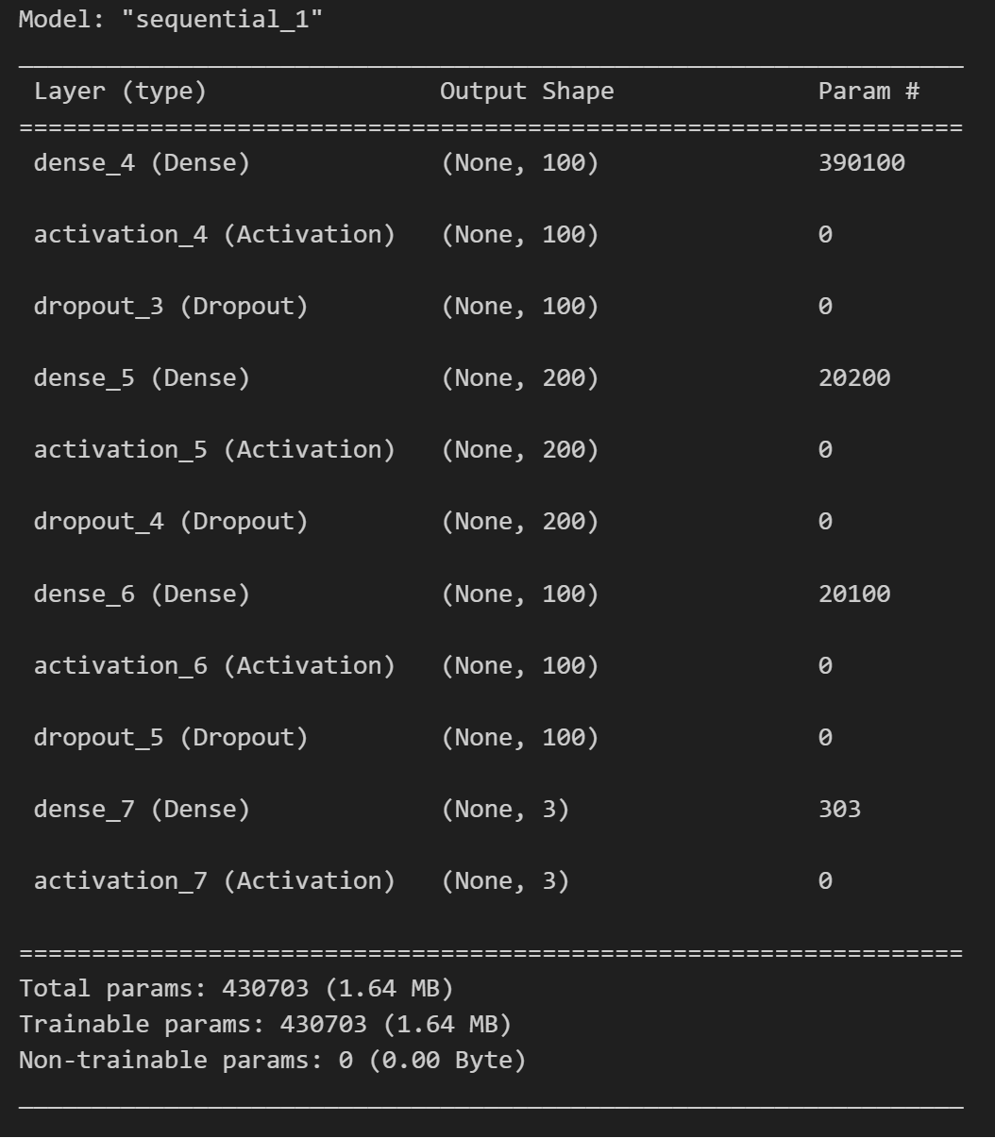
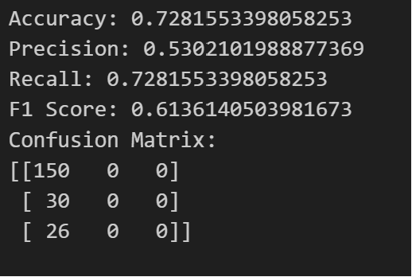
Proposed Models
DenseNet
DenseNet
“ReLU” Activation function to introduce non-linearity
Preventing overfitting
Output shape is 3 as total number of classes is 3
Notes:
This is the architecture of densenet
Here DenseNet employs the "ReLU" activation function to introduce non-linearity, while dropout is incorporated to prevent overfitting. The output shape is set to 3, reflecting the total number of classes in the classification task.

Slide 18
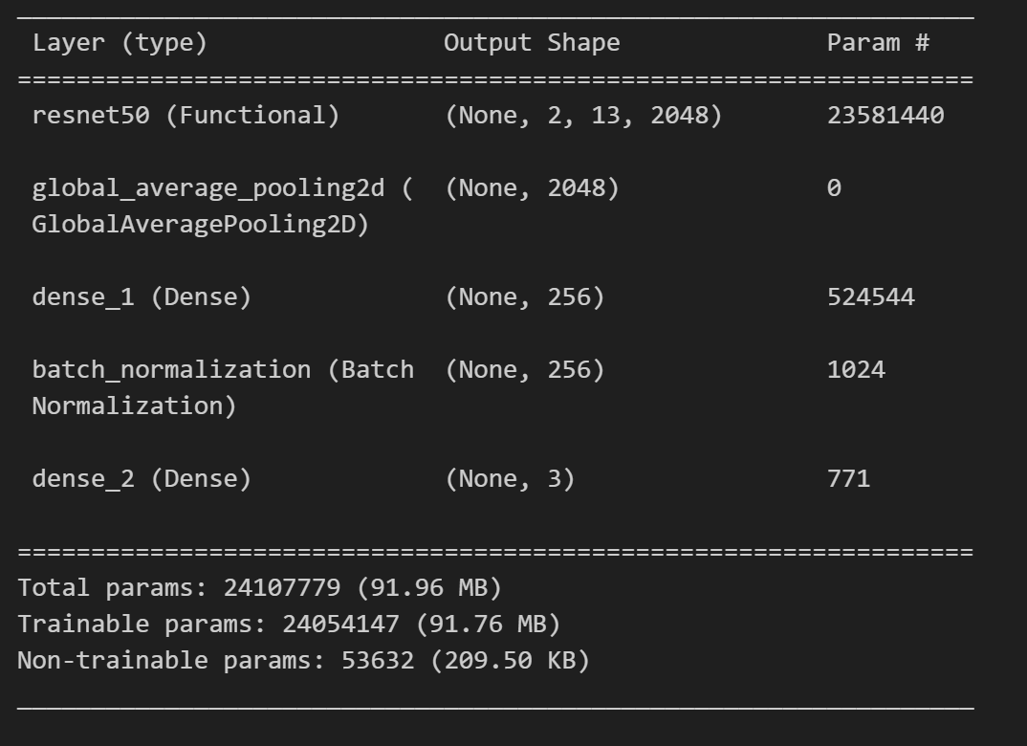
Proposed Models
ResNet
Residual Network (ResNet):
A deep neural network architecture known for effectively handling deep networks.
Its residual blocks help alleviate the vanishing gradient problem.
With 23,581,440 parameters, it constitutes the bulk of the model's complexity and capability
Helps in reducing overfitting by minimizing the total number of parameters in the model
Helps in reducing overfitting by minimizing the total number of parameters in the model

Slide 19
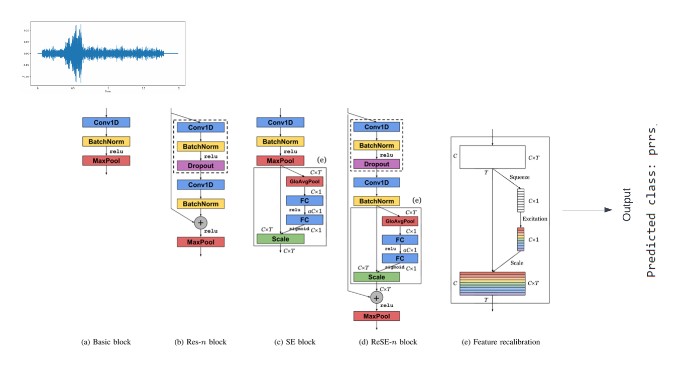
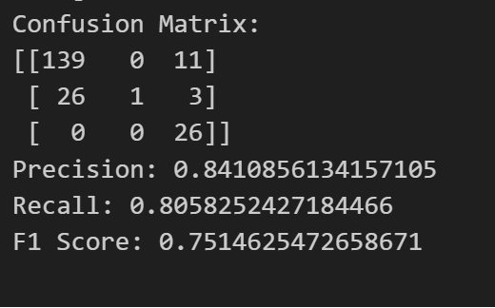
Proposed Models
ResNet
Notes:
In the ResNet architecture, audio inputs undergo a sequential processing pipeline, traversing through components such as the basic block, Res-n block, SE block, ReSE-n block, and feature recalibration. This structure enables the model to effectively capture and refine audio features at various levels, facilitating a comprehensive understanding of the input data. Ultimately, the output is generated based on the prescribed flow depicted in the diagram, resulting in refined and nuanced predictions.

Slide 20
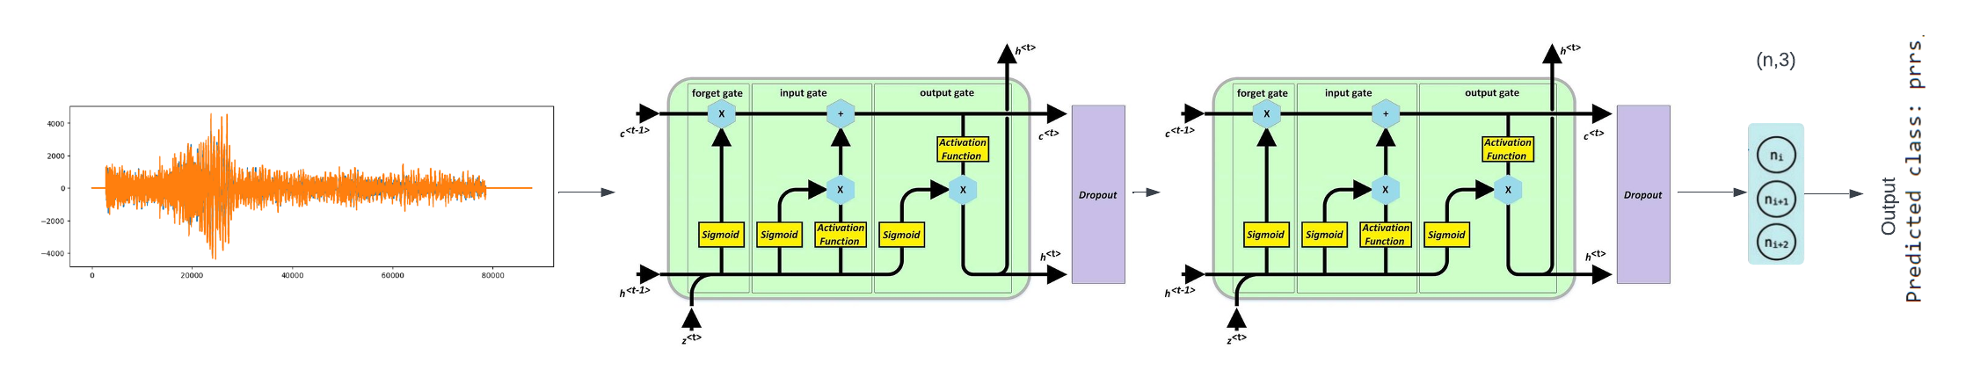
Proposed Models
Recurrent Neural Network
Recurrent Neural Network (RNN):
Specialized in processing sequences for tasks such as speech recognition or language modeling.
Capable of maintaining information in 'memory' over time to capture temporal dependencies.
Effective for analyzing time-series data or sequential data like audio signals, where past information influences the current state.

Slide 21
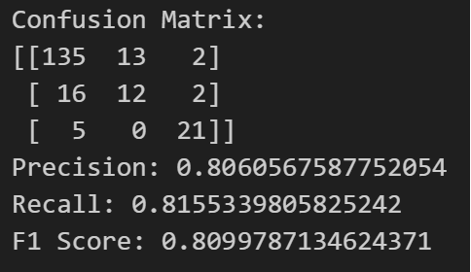
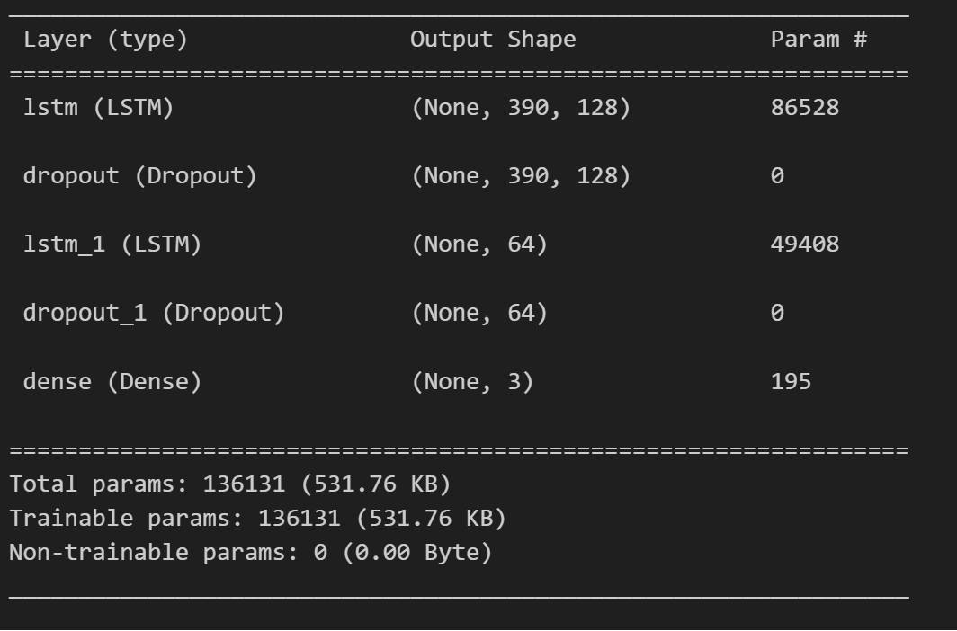
Proposed Models
Recurrent Neural Network
Helps combat overfitting by forcing the model to learn more robust features.
Does not return sequences, preparing the model for the final classification
Helps in reducing overfitting by minimizing the total number of parameters in the model
Notes:
This method helps the model avoid focusing too much on specific details, making it better at understanding different types of data. It also gets the model ready for the final decision without unnecessary information. By using fewer technical details, it prevents the model from becoming too specialized and helps it work well with various kinds of data.

Slide 22
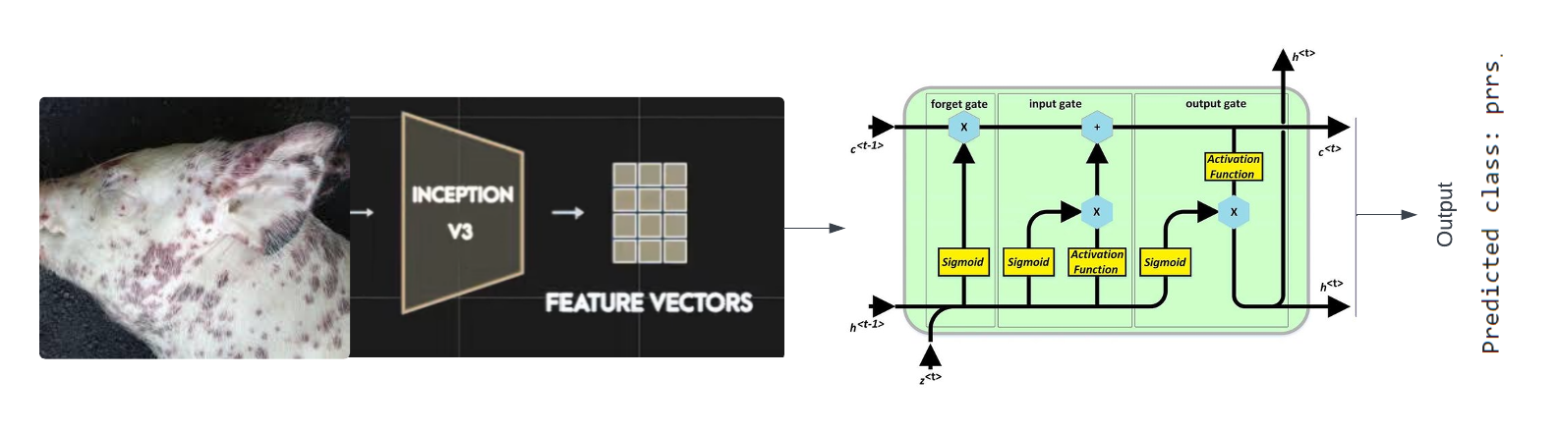
Proposed Models
LSTM
Long Short-Term Memory (LSTM):
Advanced RNN architecture capable of learning long-term dependencies in sequence data.
Ideal for time-series analysis, image classification, natural language processing, and speech recognition tasks.
Effectively handle sequences of image features, capturing temporal dynamics critical for understanding video and image.

Slide 23
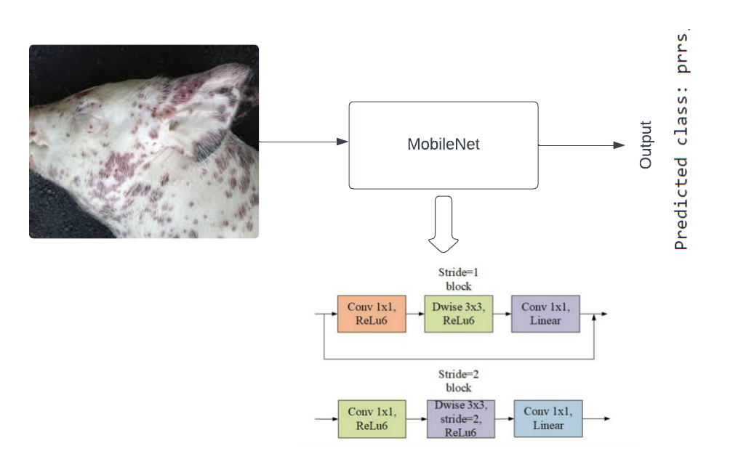
Proposed Models
MobileNet
MobileNet:
A class of efficient models for mobile and embedded vision applications.
Optimized for speed and size while maintaining accuracy, utilizing depth wise separable convolutions.
In this context, MobileNet can effectively process visual data with lower computational resources, making it suitable for real-time applications on mobile devices, such as facial recognition and object detection in images and video streams.

Slide 24
Results
MODEL | Data Type | Accuracy | Precision | Recall | F1 Score
DenseNet | Audio | 80.01% | 53.02% | 72.82% | 61.36%
RNN | Audio | 81.55% | 80.61% | 81.55% | 80.99%
ResNet | Audio | 80.58% | 84.11% | 80.58% | 75.15%
MODEL | Data Type | Accuracy
LSTM | Image | 36.80%
MobileNet | Image | 46.20%
Notes:
In the evaluation results, three models, DenseNet, RNN, and ResNet, were tested on audio data. For DenseNet, the accuracy was 80.01%, with precision at 53.02%, recall at 72.82%, and F1 score at 61.36%. RNN performed slightly better with an accuracy of 81.55%, and higher precision, recall, and F1 score. ResNet achieved an accuracy of 80.58%, with precision at 84.11%, recall at 80.58%, and F1 score at 75.15%. Additionally, two models, LSTM and MobileNet, were assessed on image data. LSTM achieved an accuracy of 36.80%, while MobileNet performed better with an accuracy of 46.20%. These results provide insights into the models' performance across different data types, with RNN showing the highest accuracy among the audio models, and MobileNet outperforming LSTM in image data classification.

Slide 25

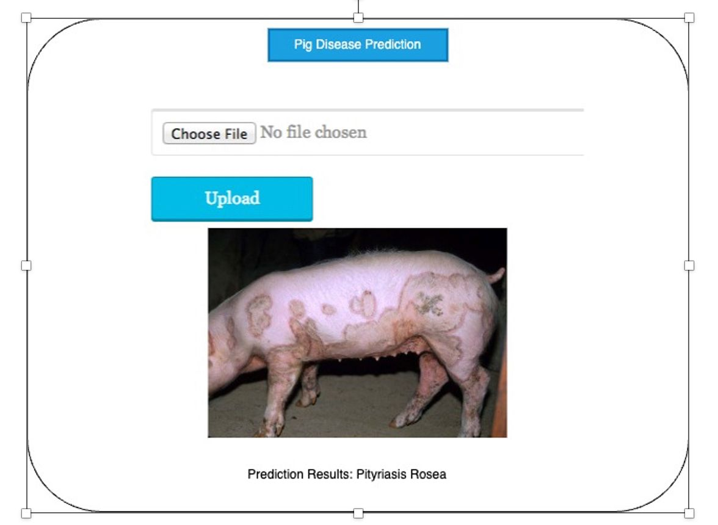






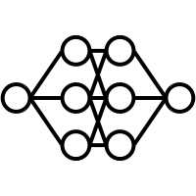






System Design
Actor
Proprietor of a swine farm
Audio Data / Image Data
System Boundary
Porcine disease data conversion
Cloud base Stored Records
Data Preprocessing
Data Conversion
Data Segmentation
Data Modeling
Potential Use Case
Handling Errors
Identifying the diseases
Determine types of Disease
Track early-stage swine disease

Slide 26










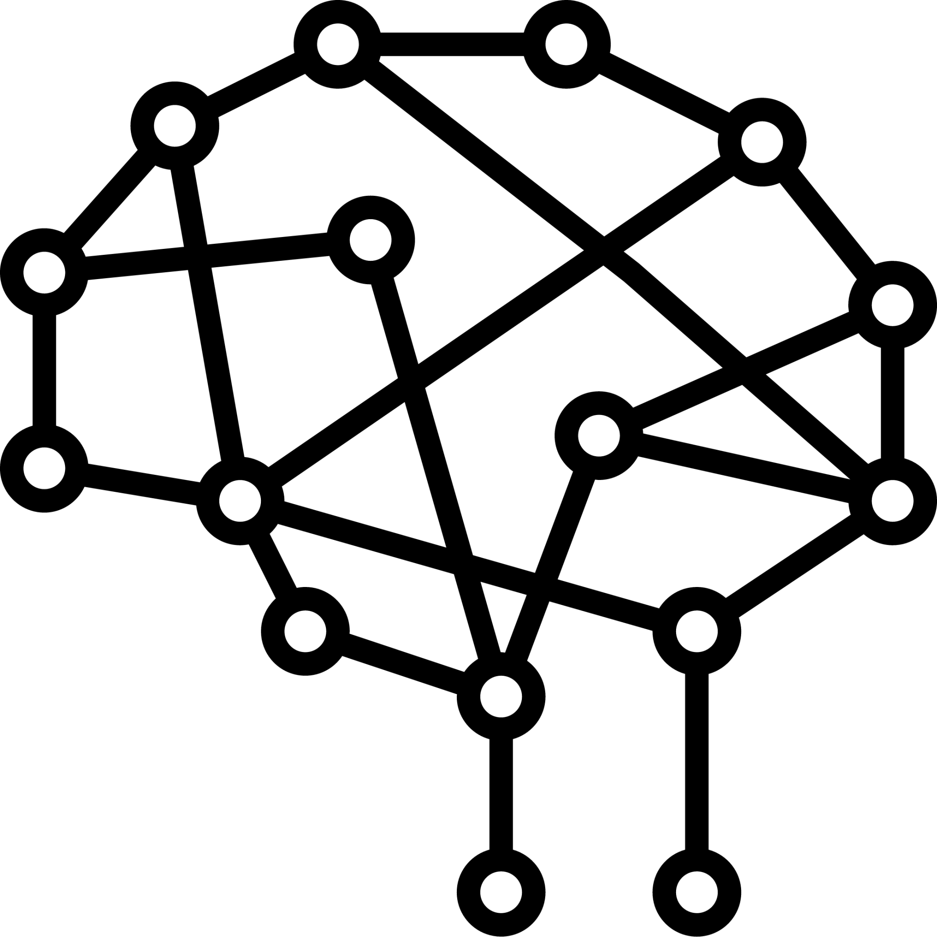

System Architecture
Frontend
Website
Output
Users
Train
Data
Test
Data
Pig Disease Prediction
Valid Data
Process Audio Data
Swine Disease Images and Audios
Backend
Deep Learning Models
Process Image Data

Slide 27
Future Scope
Enhanced Model Performance for Image and Audio Datasets:
Optimize existing deep learning architectures and algorithms to further improve model performance on image and audio datasets.
Fine-tune hyperparameters and regularization techniques for the employed models.
Enriched Data Augmentation Quality through GAN-Generated Audio:
Integrate Generative Adversarial Networks (GANs) to generate realistic audio samples for data augmentation.
Leveraging Transfer Learning:
Utilize pre-trained models and transfer learning techniques to adapt knowledge from large-scale datasets to specific image and audio tasks.
Fine-tune pre-trained models on target datasets to leverage learned features and accelerate training while improving performance.
Explore ensemble methods to combine predictions from multiple models, leveraging the strengths of each architecture for improved overall performance on diverse datasets.
Notes:
Boost current deep learning structures and methods to enhance model efficacy on visual and auditory datasets.
Can Modify the models' hyperparameters and regularization strategies.
Can Create realistic audio samples for data enhancement by integrating Generative Adversarial Networks (GANs).
Coming to Leveraging Transfer Learning:
To apply knowledge from large-scale datasets to particular picture and audio tasks, can use transfer learning techniques and pre-trained models.
Optimize pre-trained models using target datasets to make use of obtained features and boost training efficiency.
Investigate combined methods to merge forecasts from various models, relying on the advantages of every architecture to enhance overall performance across various datasets.

Slide 28
Thank You

